Slide 1
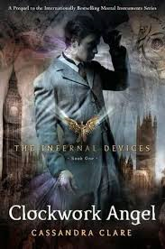
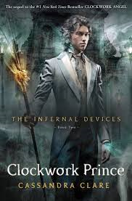
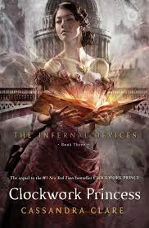
The Infernal Devices Character Quiz
BY: shadoworld.weebly.com

Slide 2
Divide into 2 teams or the amount of teams needed click to go to next slide. To see answers on slides, click again.
Time each question for 30 seconds each
Each question is worth 1 point

Slide 3
Who is the key for Mortmain’s plan?
Sophie Collins
Charlotte Branwell
Jessamine Lovelace
Tessa Gray
Click for the Answer
D

Slide 4
To whom does Tessa get engaged to?
Will Herondale
Jem Carstairs
Gabriel Lightwood
Gideon Lightwood
Click here for the answer
B

Slide 5
Who wants to drink from the Mortal Cup and ascend to become a shadowhunter?
Bridget
Cyril
Thomas
Sophie
Click here for the answer
D

Slide 6
Who thought they were cursed?
Jem Carstairs
Will Herondale
Cecily Herondale
Ella Herondale
Click here for the answer
B

Slide 7
Who is poisoned?
Will Herondale
Charlotte Branwell
Jem Carstairs
Tessa Gray
Click here for the answer
C

Slide 8
Who is Tessa’s favorite servant?
Bridgit
Cyril
Sophie
Thomas
Click here for the answer
C

Slide 9
Who is in love with Tessa, besides Jem?
Axel Mortmain
Gideon Lightwood
Will Herondale
Henry Branwell
Click here for the answer
C

Slide 10
Who is the inventor in the London Institute?
Henry Branwell
Jem Carstairs
Charlotte Branwell
Bridgit
Click here for the answer
A

Slide 11
What are the dark sisters’ real names?
Mrs. Black and Mrs. Grey
Mrs. Dark and Mrs. Black
Mrs. Night and Mrs. Dark
Mrs. Grey and Mrs. Blue
Click here for the answer
B

Slide 12
Who made the clockwork angel that hangs around Tessa’s throat?
Mr. Shade
Mrs. Shade
Axel Mortmain
Elizabeth Gray
Click here for the answer
A

Slide 13
Who is Aloysius Starkweather’s grandaughter?
Adele Starkweather
Elizabeth Gray
Charlotte Branwell
Jessamine Lovelace
Click here for the answer
B

Slide 14
Total up your scores..
Each question is worth one point

Slide 15
Calm Down
There is going to be a very hard bonus question.
The team that is losing gets to do the bonus question. If there is a tie, both teams go and the first one with the correct answer wins.
This question is worth 3 points
Good Luck!

Slide 16
What ends up happening to Jem?
He dies
He turns into a werewolf
He turns into a vampire
He turns into a silent brother
Click here for the answer
D

Slide 17
Now total up, and see who won!
Thanks for watching! Visit shadoworld.weebly.com for more quizzes, pictures, spoilers, audiobooks, and much more!

